Slide 1
Transforming for Sustainability Intermediation – An Opportunity for Irish Credit Unions
Notes:
As the Credit Union business model evolves and develops, it is worthwhile to assess and review the services and products we provide to our members. We have not offered Intermediated financial products such as insurances, investments and pensions to our members albeit that these are products many of our members have a requirement for. As part of the CEO Steering Group agenda, a decision was taken to establish a workstream to review and assess to review opportunities in this broad area.

Slide 2
ASSESSING THE OPPORTUNITY
THE APPROACH
BACKGROUND
STRATEGIC REVENUE & BUSINESS GROWTH
WHAT DO MEMBERS
THINK
1.
WHY CONSIDER INTERMEDIATION AT THIS POINT – HOW RELEVANT IS IT?
2.
WHAT ARE THE OPPORTUNITIES; WHICH HAVE BEST FIT FOR US CURRENTLY
3.
IS THERE A DEMAND FOR INTERMEDIATED PRODUCTS / SERVICES & WOULD THEY BUY FROM US
INTERMEDIATION OPTIONS – HOW TO & WHICH IS BEST
HOW TO APPROACH
THE OPPORTUNITY
CONSIDERATIONS & WHO
TO PARTNER WITH
4.
5.
A FRAMEWORK TO GET STARTED ON THE INTERMEDIATION JOURNEY
6.
WHAT ARE THE CRITICAL ELEMENTS AS YOU UNDERTAKE DUE DILIGENCE
WHAT IS AVAILABLE IN THE MARKET AND WHAT MAY BEST SUIT CUs.
INTERMEDIATION IS ABOUT FULFILLING MEMBER NEEDS; NOT BALANCE SHEET MANAGEMENT
Notes:
A structured assessment approach was taken under 6 headings and we will expand on each of these as we go through the paper, outlining key findings and recommendations.

Slide 3
INTERMEDIATION – BACKGROUND
Less than 1% of overall income in Irish Credit Unions is derived from non funds based sources. This compares to a norm of 20%+ in North America. However, much of the non funds based income comes from fees & charges.
There appears to be little appetite in the Irish Credit Union sector to introduce a schedule of approved fees & charges.
A proliferation of approaches by individual credit unions to deliver non funds income have not been successful in a meaningful way.
Intermediation is all about selling and doing so ethically; to do this, a Sales Model, CRM & Data engine are key enablers.
A large capability gap is evident in CU sector compared to other financial services operators who have been selling for decades
No customer segmentation model – thus our marketing & promotion is more costly & much less effective.
Lack of a professional Needs Based Sales Model - we are typically order takers & do not complete an analysis of members financial needs.
Of all CU approaches, St Jarlath’s is the current reference point in terms of scale, investment and plans for the future.
The market for insurance products & pensions is growing. However, apart from life & pensions, insurance is a very low margin business.
Providers are fast investing in digital delivery to drive costs down.
For a new entrant, a significant investment in digital & marketing is required.
Credit Unions have wonderful reputation and brand loyalty:
Reputation & advice are key drivers for consumers when considering purchase of higher value life products & pensions.
This is a key differentiator that CUs can potentially exploit…..but how?
Many operators are/would be keen to get involved in the CU sector (CUNA/Peopl, Metamo, ILCU) & Others – but what best benefits members & CUs?
Notes:
It is interesting to note that Credit Union in other jurisdictions generate significant income from sources other than loan interest and investments. This income is derived from the sale of intermediated products and the application pf a range of transaction and other service fees and charges such as payment fees.
It is clear from research that to provide intermediated products, you need a professional needs based sales model. This includes IT and digital enablement but most importantly, staff skills, knowledge and experience is key to such a model…………and we have a capability gap on that front.
It is interesting to note that the market for insurances and pensions is growing and trust is a key factor when consumers buy such products. Given our reputation in local marketplaces all over Ireland, it is reasonable to assume we would have the trust of our members should we enter into these sectors.
Our members have financial needs and there is a good opportunity for us to develop a proposition that fulfils those needs and help us to provide an even better service.

Slide 4
‘Irish credit unions deservedly have a highly respected brand and enjoy the loyal trust of members.
This trust coupled with the sector co-operative member-centric ethos, is a competitive difference upon which to build future business model ‘
Patrick Casey, RCU, Sept. 2019
BUT HOW DO WE LEVERAGE THAT DIFFERENCE & BUILD SUSTAINABILITY?
Notes:
Trust is key – we have the reputation and the brand; the challenge is how do we leverage this to support our members and communities and at that same time evolve our business model to ensure sustainability.

Slide 5
REVENUE & BUSINESS GROWTH
WHAT ARE THE OPPORTUNITIES
IN THE MARKETPLACE
FOR LONG TERM STRATEGIC GROWTH
AND ENHANCED
REVENUES
Notes:
What are the opportunities that can enable us to grow in a successful and sustainable manner?

Slide 6
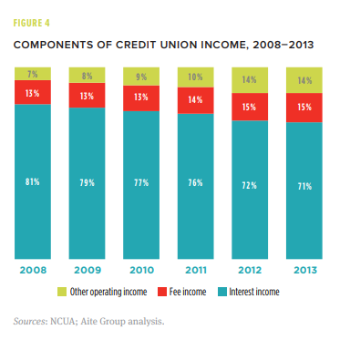
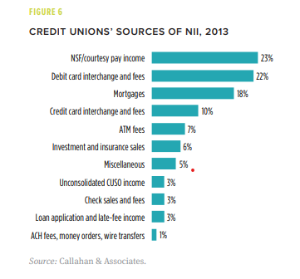
REVENUE & INCOME CONSIDERATIONS
GENERATING < 20% OF INCOME FROM NON INTEREST ACTIVITIES
To generate a meaningful level of income (>5%?) from non funds sources, a range of activities need to be considered, many of which are already permitted. This is where Credit Unions in other countries generate substantial revenues:
Charges
Account maintenance charges
Money Transmission Charges
ATM charges
Loan Application Fees
Penalties?
Cross Sale revenues
Life & General Insurances
SME Income Protection & Keyman
Investment product sales
Retirement/PRSA sales
Other – credit products e.g. Leasing Finance
Introduction of charges is a hot & controversial topic – would the member pay? Of course they would if the offer is right…. & being member centric does not infer everything is for free
What is the value of a credit union membership and what should it cost?
Notes:
Earlier, it was stated that credit unions in other jurisdictions generate significant income from ancillary activities. And some of these are listed here;
Historically, we have not levied charges on our members and have chosen not to do so even when regulation approved us to do so. This is very much a cultural choice, but as the Credit Union business model comes under increased pressure, this surely will need to be reviewed; maybe not changed but practically and logically reviewed.
What is the value of a credit union membership? It is not all about price – for example, research is clear that price is not in the Top 3 factors when consumers want a personal loan – convenience and service score a lot higher than price.
So in reviewing any business model, it makes sense to look at what the available options are, review these and make informed choices.

Slide 7
BUSINESS GROWTH STRATEGIES- HOW DO WE?
Data suggests that we are circa 25% ‘lent’ across the sector & share growth far outstrips loan growth
We have not developed our proposition beyond lending
Income growth & new income sources are critical to sustainability
So, there is a compelling case to broaden what we offer our members?
What can we offer to them that they already buy elsewhere?
Insurances offer an opportunity to do just that;
In doing so we can broaden our attractiveness to a broader cohort of consumers, building our membership base
New
Diversification Strategy
High degree of mistrust in the financial services sector - an opportunity for Credit Unions to become a leader in some sectors?
Market Development
expanding our proposition will attract consumers who may not have considered us before
Growth
Strategies
Markets
Market Penetration
organic growth locally for existing products in existing sectors
Product development
E.g. our members buy insurance products elsewhere; could we provide fair, value for money products to our communities
Current
Current
Products
New
Notes:
It is universally accepted that developing related products in your existing customer base or market, is much less costly and risky than developing new markets. New markets with new products is a tough ask - very costly to break into.
Developing a proposition for member around financial products they already have a need for and buy elsewhere, is a less costly and less risky way to grow our business. In addition, such a move can expand the Credit Unions appeal to a greater audience. Therefore, from strategic perspective, this looks like a reasonable approach.

Slide 8
SWOT – INTERMEDIATION IN CREDIT UNIONS
INSURANCES, INVESTMENTS, PENSIONS, ASSOCIATED CREDIT PRODUCTS
INTERNAL FACTORS
EXTERNAL FACTORS
STRENGTHS
OPPORTUNITIES
REALLY STRONG BRAND & REPUTATION
MASSIVE MEMBER DATABASE & LOYALTY
EXCELLENT MEMBER RELATIONSHIPS; BUT INERT FROM A FINANCIAL NEEDS BASIS – CU PROPOSITION DOES NOT SERVE ALL THEIR NEEDS
GROWING MARKET – NEW SEGMENTS, PENSIONS TIMEBOMB, INTEREST RATE ENVIRONMENT
SOME OPERATORS DEVELOPING ATTRACTIVE INTERMEDIATED SOLUTIONS FOR CUs
BROADEN THE MEMBER PROPOSITON TO SERVE FURTHER FINANCIAL NEEDS; FAIRLY, ETHICALY, PROFITABLY
POSITIVE
WEAKNESSES
THREATS
NO STRUCTURED SALES MODEL – WE DON’T DISCUSS MEMBERS BROADER FINANCIAL NEEDS & HELP ADDRESS
DATA MANAGEMENT, SEGMENTATION & MARKETING IS POOR & INEFFICIENT
FINANCIAL CONSTRAINTS FOR MANY CUs
CHANNEL MIX – YES WE HAVE ONLINE BUT ITS BASIC
INDUSTRY PLAYERS HEAVILY INVESTING IN MULTI CHANNEL DIGITAL FIRST SOLUTIONS; DRIVING DOWN COST TO SERVE & RACE TO THE BOTTOM
PSD2 & OTHER DEVELOPMENTS BRING COMPLEXITY & FURTHER COMPETITION
ENDURING COVID 19 FINANCIAL IMPACT
NEGATIVE
BUT WE HAVE THE MEMBERS & AN UNPARALLELED REPUTATION
Notes:
It is useful to look at the opportunity through the lens of a SWOT analysis, getting a one page high level view is useful as a starter; and again, the strong messages coming through are our unparalleled reputation, the opportunities that exist in the market but also our very apparent challenges around our structure and the enablement we may lack.

Slide 9
STRATEGIC GROWTH OPPORTUNITIES
SUMMARY
We have an unrivalled reputation in the marketplace
Most Trusted Brand and massive loyalty from countless members.
Our culture is that of small lending and member centricity; we are masters at this.
Doing more business with your existing member base is less costly & less risky than investing in new markets.
We are foregoing significant income in transactional and other fees we are already approved to charge.
Our members have a multitude of other financial needs that, based on feedback, they would trust us to satisfy.
Doing so would generate new revenue streams for us, building sustainability when we need it.
There is no ethical consumer champion in banking or insurance activities, hence an opportunity for someone to claim that space.
We do not have a sales culture, structured model & infrastructure which are key enablers if we expand the proposition outside of core activities.
And to do so needs know how, technology and competence; elements we need the right partners to deliver for us.
The key is selecting the right activities, the right model and the right partner.
Insurance is a good starter – products that our members have a proven need for and already buy elsewhere.
Notes:
Pulling it all together at a strategic level, we have enormous strengths that can be leveraged if we get involved in the right activities, with the right support and right model. Insurance would appear to be an activity that provides such an opportunity but reviewing our approach to fees & charges makes sense at a point in time where our business model is coming under continued pressure.

Slide 10
WHAT DO MEMBERS THINK?
THE RESEARCH;
WOULD THEY LIKE TO SEE US PROVIDE THESE SERVICES
& WOULD THEY BUY FROM US?
Notes:
So, if insurance appears to be a good option to pursue, what do members think?

Slide 11
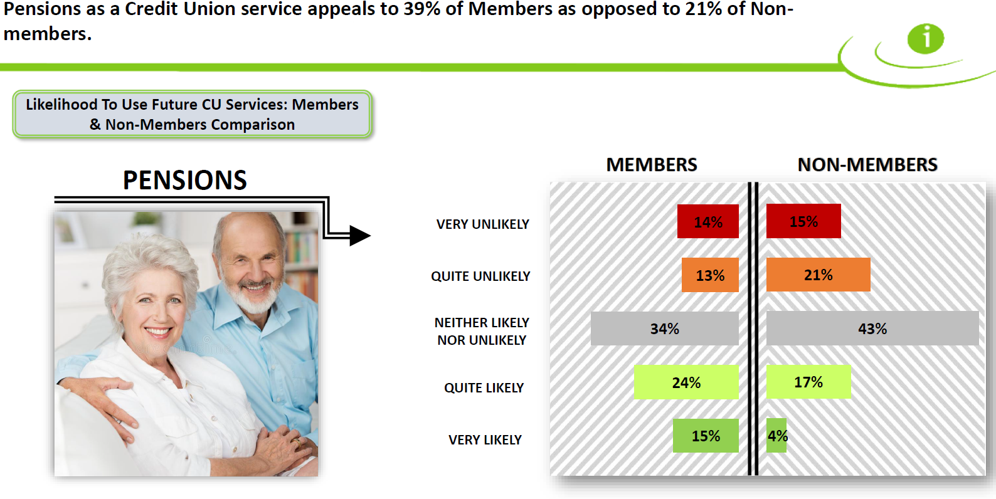
Research suggests a certain level of interest; but membership is key……
Source: iReach
Notes:
This research, courtesy of iReach, shows a strong level of interest in considering the credit union as a credible provider. Interesting to note also that around one in five non members would consider us at the outset.

Slide 12
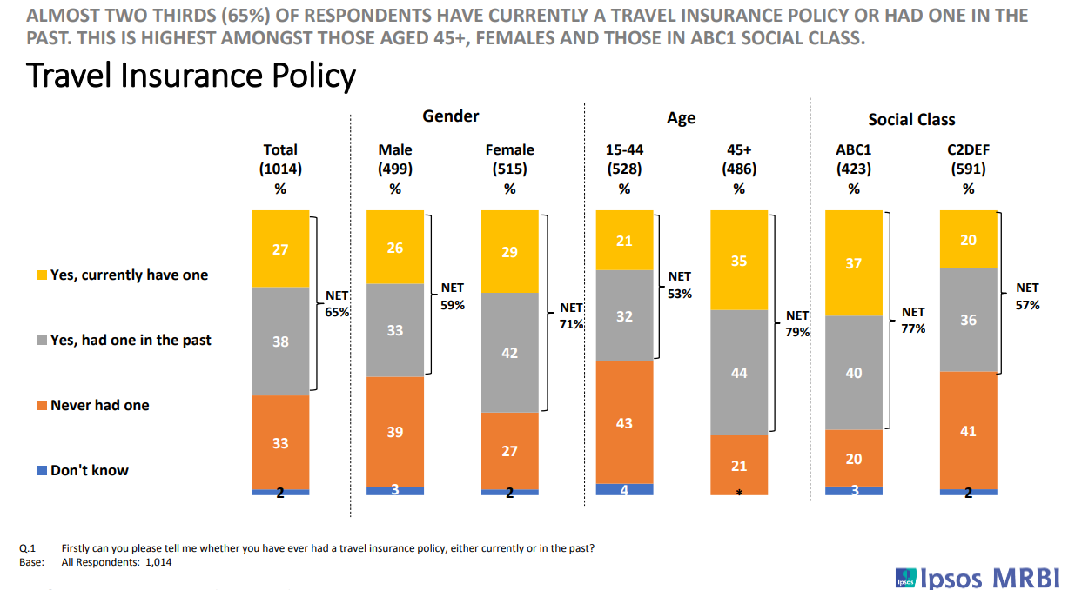
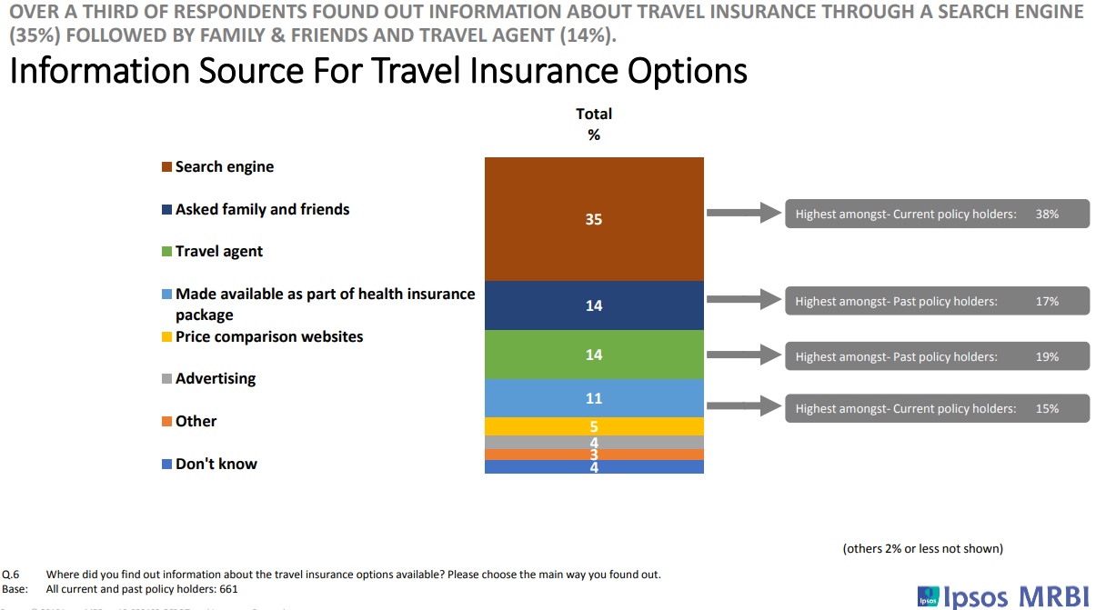
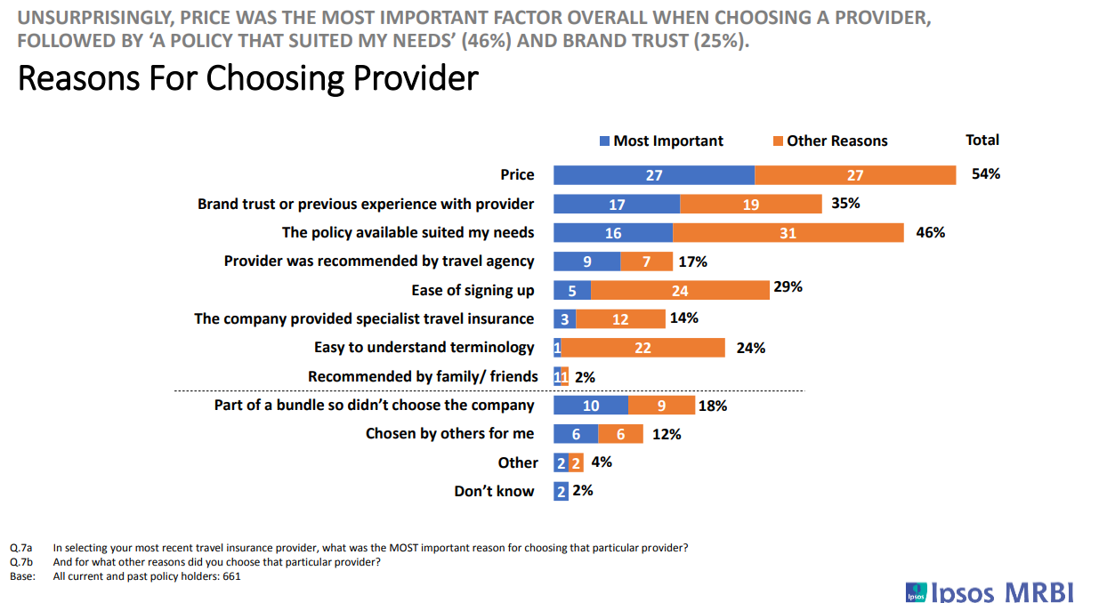
65% of respondents currently have a travel insurance policy or have had one in the past. This is highest amongst those aged 45+ (79%), females (71%) & those in ABC1 social group (77%).
The most important reason for taking out travel insurance was peace of mind at 66%. A variety of secondary reasons were cited including advice from family/friends, that the policy seemed good value.
Unsurprisingly, price was the most important factor overall when choosing a provider (54%), followed by ‘a policy that suited my needs’ (46%) and brand trust (35%).
A value for money, Credit Union (Trusted Brand) offering, primarily promoted & delivered online would appear to be ideal for a large cohort
Source: iReach
Notes:
The travel insurance sub segment is an interesting case in point; trust,, value for money, things that are at the core of what we are, are principal drivers in the consumer’s decision making process. But important to note that online delivery , a new channel for us, is also key

Slide 13
The likelihood of members availing of the four proposed new services is high across the board with a digital loan process and pensions advice marginally ahead of investment advice and insurance intermediation. Base: All Members - 400
Digital loan application process |  | Pensions Advice & Retirement Planning |  | Investment Advice |  | Insurance Intermed iation
% |  | % |  | % |  | %
Very likely
Fairly likely
Neither likely nor unlikely
Fairly unlikely
Very unlikely Don’t know
Higher amongst C2DEs –
27%
Higher amongst C2DEs
–27%
Higher amongst U35s - 42%
Those likely to be in market for a loan – 39%
Mean score | 4.26 |  | 4.16 |  | 4.09 |  | 4.02
?
Q.19 St. Jarlath’s Credit Union is currently looking to develop a range of products and services with the aim of fulfilling its member’s financial needs and expectations now and into the future. How likely do you think you would be to avail of the following services should they become available at St. Jarlath’s Credit Union?
Notes:
St Jarlaths are a reference point in intermediation in the credit union sector. Thanks to John Doyle for sharing the knowledge and experience that Jarlaths have gained to date. And again, strong responses coming through from members

Slide 14
MEMBER RESEARCH
SUMMARY
Members are twice as likely to be interested an intermediated offer from the Credit Union as opposed to non members….however, 20 % of non members indicated a level of interest also!
Circa 40% of members indicate they would be interested in Insurance, Pension & Life; this is higher with St Jarlath’s……maybe local factors influence the response.
Trust is a key driver – this is apparent across the industry.
A value for money, ethical offering would appear to be ideal for a large cohort of members and consumers.
There are opportunities in emerging and niche sectors such as gadget and travel.
Multi channel access is attractive for some segments and products.
Overall, it appears we would get a relatively good response if we actively became involved in insurances and pensions.
We are trusted.
Notes:
Overall, plenty of good and positive feedback from members. Trust is a key factor and given our reputation on this front, a CU proposition would be well received. That said, we need to note the multi channel and online elements,

Slide 15
CONFIGURING TO DELIVER
AN INTERMEDIATED PROPOSITION;
WHAT ARE THE OPTIONS & WHICH MIGHT BE BEST
Notes:
So, what are the options and important factors that needs to be considered.

Slide 16
INTERMEDIATION -THREE BROAD OPTIONS
INTRODUCTION/REFERROR BASIS
TIED AGENCY BASIS
MULTI AGENCY INTERMEDIARY BASIS
Credit Union refers members to a partner company but provides no advice
Under Insurance Distribution Directive, no authorisation reqd to provide a service on an introduction/referral basis
Does not constitute the provision of advice to the customer.
Care required by Credit unions to ensure they do not endorse product/induce the member to buy the product, actions which could be construed as providing advice.
Exactly what it says – a Credit Union is ‘tied’ to one insurance company & sells it’s products.
Insurance company or other intermediary that appoints a Tied Insurance Intermediary remains fully & unconditionally responsible for any act or omission by the Tied Insurance Intermediary when acting on its behalf!
Given level of risk, trend in the industry is away from Tied Agency
Credit union provides insurance advice as an independent, multi-agency intermediary
It is then exposed to a range of additional risks incl legal/reputational/insurance/operational & governance.
Differs from tied agent, where the insurer is liable for any act/omission; the credit union is now liable for these risks.
It must hold the proper insurance and/or investment authorisations.
Section 48 Approval required.
Notes:
3 high level approaches – given recent trends in the market, the choice is down to introducer or referrer, or a multi agency intermediary structure. As you can see, these have different implications that are expanded on the next slide also.

Slide 17
CREDIT UNION - WHICH ROUTE TO GO?
COMPARING 2 MODELS
INTRODUCER/REFERROR
MULTI AGENCY INTERMEDIARY
Requires less investment upfront; systems & infrastructure provided by partner/third party
Significant infrastructural investment required in systems upfront
HR – existing MCR complaint staff are typically sufficient
HR – investment required in CFP qualified hires and/or other professionals with experience
Member ‘Ownership’ a potential concern, based on previous experience with Insurance companies
‘Ownership’ of member rests with CU with less concerns about dilution.
CU Marketing capability typically poor – the right partner brings this expertise & deep pocket!
Marketing capability a real challenge. Significant investment required to build a business of scale
Data Analytics engine is typically provided by the partner
Analytics requires potentially significant tech investment and hire(s)
REFERROR MODEL IS INITIALLY LESS RISKY..LOWER ENTRY COSTS BUT CONSEQUENTLY LOWER REVENUES THAN MULTI AGENCY ROUTE – HIGH SET UP COSTS BUT FAR GREATER REVENUES
Notes:
REFERROR MODEL IS INITIALLY LESS RISKY..LOWER ENTRY COSTS initially BUT CONSEQUENTLY LOWER REVENUES THAN MULTI AGENCY ROUTE which has HIGH SET UP COSTS BUT FAR GREATER REVENUES potentially;
Next we will look at some of the options in terms of who to partner with; who can provide these services to a credit union wishing to embark on one route or the other.

Slide 18
Financial Services
Providers
delivering
Insurance, Investment & other products
There are multiple providers in the marketplace with expertise in delivering intermediated solutions.
Irish Life for example, provide a highly integrated solution to AIB, PTSB & KBC retail banks for Life, Investment & Retirement planning propositions.
Zurich, Aviva, New Ireland and others have deep expertise and offer similar propositions to the large broker segment.
On the credit side, most of the retail banks have a mortgage broker proposition; Avant Money, new to market distribute exclusively through brokers; Grenka, a German lender offering leasing both direct, through brokers and through KBC Bank.
There are numerous insurance companies/manufacturers in the market who would potentially be interested in developing a relationship with specific individual Credit Unions or groups
So, there are many options our there covering various segments

Slide 19
New thinking in the Sector
- Creating (sub) Brands for Insurance, Investment & other products
Notes:
We will briefly refer to 3 operators who either have an existing proposition available to a credit union today or indeed are about to launch

Slide 20
TIED AGENT MODEL IS ONE EXAMPLE OF WHAT METAMO
OFFERS TO CREDIT UNION PARTNERS
MANUFACTURER &
PARTNER
COMPONENT PRODUCTION
CREDIT UNION
PARTNERS
SUBASSEMBLY
FINAL ASSEMBLY
Product Manufacture
Risk & Compliance
Support Activities
IT & Digital back end
Data Infrastructure
Managing all 3rd party relationships/contracts
Marketing & Distribution strategy
Proposition development & management
Training & Consistency
Green marketing is a practice whereby companies seek to go above and beyond traditional marketing by promoting environmental core values in the hope.
Front end distribution
Member engagement, advice & service
Managing member relationships
Local promotion
MATERIALS PLANNING
INTEGRATED END TO END PROPOSITION MANAGEMENT
SUPPORT ACTIVITIES
ONGOING FRONTLINE
EDUCATION & TRAINING
GROWTH STRATEGIES &
CAMPAIGNS
SYNERGIES
POLICIES & REGULATION
SUPPORT
ONGOING PROPOSITION
DEVELOPMENT
Notes:
Metamo, a joint investment from a number of credit unions and Fexco are providing a Tied Agency type model to their partner/shareholder credit unions – an end to end proposition. Further detail are available from Metamo should you be interested in looking at this approach as an option for your credit union;.

Slide 21
BROAD, MULTI AGENCY INSURANCE PROPOSITION FOR CREDIT UNIONS
WHAT IS IT?
A COMPOSITE RANGE OF INSURANCE PRODUCTS – GENERAL, LIFE, TRAVEL
MULTI CHANNEL DISTRIBUTION PROVIDING EFFICIENCY & ‘ALWAYS ON’. START IN ONE CHANNEL, COMPLETE IN ANOTHER
MULTI PROVIDER PRICING TO ENSURE BEST PROPOSITION & MOST COMPETITIVE PRICING
BASED ON FAIR PRINCIPLES
ALL CHANNELS PROVIDED & SUPPORTED BY PEOPL GIVING CREDIT UNIONS ACCESS TO MARKET LEADING ENABLEMENT & PRODUCTS
DATA ANALYTICS – COMPREHENSIVE ANALYTICS QUOTE ENGINE & MARKETING SUITE; MORE EFFICIENT & BETTER MEMBER MARKETING & COMMUNICATIONS
Notes:
Peopl; a new brand and proposition from CUNA Mutual

Slide 22
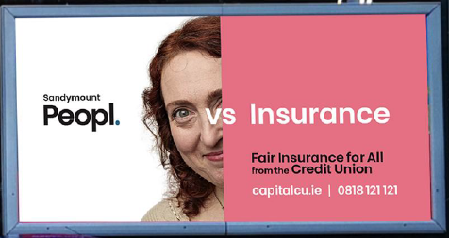
Vibrant branding;
emphasises what members
& consumers said they
wanted;
Fair Insurances

Slide 23
ILCU –
INTRODUCER MODEL
Referral scheme for life and non-life products – ILCU Financial Planning & Coveru
No Capital Investment required
Referral/Introduction Only minimises associated costs for participating credit union; lower costs around risk & regulation versus other intermediation models
Full support from insurance professionals in ILCU, Zurich Life and Marsh Ireland
Full staff training delivered remotely; marketing support & material from ILCU & partners
Notes:
A full referrer or introducer model where a credit union passes on a referral only.

Slide 24
ILCU have partnered with Marsh Ireland
Global insurance broker - offices in Dublin, Cork & Galway
Specialists in Irish market for affinity schemes e.eg. Coveru
Exclusive rates for credit union members
Car Insurance, Home Insurance, Travel Insurance
Can source cover for non-standard risks e.g. holiday homes, rental properties & commercial vehicles

Slide 25
A ROADMAP
FOR A CREDIT UNION
A ROADMAP FOR ASSESSING & PROGRESSING THE OPPORTUNITY
CONSIDERING THE REGULATORY IMPLICATIONS & REQUIREMENTS
THE KEY – UNDERSTANDING & MANAGING THE MEMBER EXPERIENCE
SELECTING THE RIGHT PARTNER – SOME CONSIDERATIONS
FROM PLANNING TO DOING
Notes:
So, what is the best approach to setting out on the intermediary route? What are the things that need to be considered and assessed? Here are some suggestions.

Slide 26
INTERMEDIATION – GETTING STARTED
WHAT IS PRACTICALLY POSSIBLE FOR A CREDIT UNION
DEPENDENCIES
& GAP ANALYSIS
REVIEW
HR ASSESMENT
CURRENT STRUCTURE & FINANCIAL CAPABILITY FOR A SIGNIFICANT INVESTMENT; BOARD ENGAGEMENT, UNDERSTANDING & COMMITMENT
DO I HAVE THE MANAGEMENT & STAFF CAPABILITY TO CREATE, DELIVER & MANAGE A SALES MODEL & ASSOCIATED ACTIVITIES?
CRUCIAL!
WHAT ARE MY GAPS & HOW DO I ADDRESS THESE? WHAT PARTNERS WOULD HELP, DO THE HEAVY LIFTING & BE A GOOD FIT
THERE ARE MULTIPLE OPTIONS & MULTIPLE PARTNERS; SOME WHO CAN MITIGATE RISK & SUPPORT A ‘START UP’
CONSULT WITH POTENTIAL PARTNERS TO: DEFINE A PRACTICAL OPERATING MODEL; ASSESS, REFINE, ASSESS, REFINE
DO THE BUSINESS CASE – THE PARTNER WILL HELP; COLLEAGUE CUs WILL INFORM; INVESTMENT REQUIRED, POTENTIAL REVENUES, RISK, COST INCOME MODEL; TIMELINES?
WHAT ACTIVITIES
SHOULD WE CONSIDER
WHAT WOULD A
MODEL LOOK LIKE
WHAT ARE THE
ECONOMICS
CULTURAL ISSUES ARE A CHALLENGE & NEED TO BE CONSIDERED!!
Notes:
Firstly, a roadmap is useful in setting out the journey and the steps that need to be taken. This is a suggested approach and there are many elements underlying each of the headings.

Slide 27
The Regulatory landscape for Intermediation
ITEMS FOR CONSIDERATION
Minimum Competency Code 2017 (MCC)/ Appropriately Qualified Staff
As per the MCC 2017 Code and CBOI Minimum Competency Regulations, MCC applies to CUs when acting as retail intermediaries.
Person(s) carrying out Pre-Approval Controlled Functions or Controlled Function roles within firms authorised under the IIA or IMR, must meet minimum MCR as set out in the MCC
Fitness and Probity Standards
CPD generally require a CU to nominate a ‘person(s) responsible for insurance mediation’ within the CU, although not an F&P role.
Professional Indemnity Insurance (PII)
Professional Indemnity Insurance (PII) is required for all entities registered under the IDD.
Required in respect of each regulated activity, i.e. Insurance distribution & also for investment business activity.
The Consumer Protection Code
The CPC is applicable to CUs when acting as insurance intermediaries under the IDD.
Conflict of interest
Credit union acting as a retail intermediaries must not incentivise or remunerate the performance of their employees in a manner that would conflict with their duty to act in the best interests of members.
Others also apply – Statutory Reporting, Investment Intermediary Regulation, Industry Funding levy……
Notes:
It is critical to consider and assess the regulatory landscape and the requirements that need to be fulfilled..

Slide 28
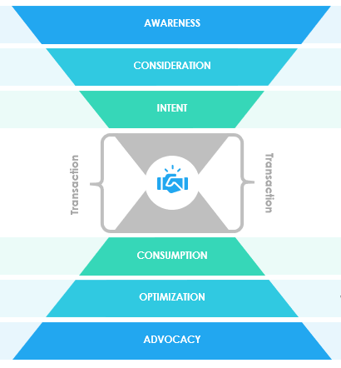
MANAGING THE MEMBER EXPERIENCE
KEY CONSIDERATIONS?
Ownership of Data has to be a given – CU owns the member data & this is a crucial principle that requires clarity & management.
It is all about a Member Journey – this requires end to end expertise and management; if the journey breaks down, where does the member go & what is the impact of the relationship?
How to ensure consistency of Member Experience
Omni Channel – branch, phone, online, mobile
Service levels & Service quality– interlinked but different sides of the same coin - need to be consistent in all channels
Member queries & problems
Where do I go when I have a problem?
If it is into the credit union, then we have a problem!
Staff knowledge & capability is an issue
Queues?
End to End Sales Model – sales combined with service to fulfil member needs fairly, ethically and at a price that makes sense to all!
Get it right & you get very satisfied members recurring income streams
OUR U.S.P. IS OUR REPUTATION & LOYALTY – THIS HAS TO BE AT THE HEART OF ALL WE DO
Notes:
We live and die by the overall member experience we deliver. It is critical to ensure that this is rigorously assessed and considered. Who owns the customer/member in a given structure; who makes the primary contact; is there a full line of sight for the credit union: what channels are to be provided and how are these managed: who is providing services….where are the based?
What happens when there is a problem?
Who controls pricing?.............can this have an impact on your reputation?
There are numerous questions to be raised in regard what your member will experience as a potential customer of another entity, having been introduced by you
And the right partner or supplier is the key to this

Slide 29
SELECTING THE RIGHT PARTNER FOR YOUR CREDIT UNION
DUE DILIGENCE IS CRITICAL
PARTNER CRITICAL DUE DILIGENCE
THEIR TRACK RECORD IN PRODUCT INNOVATION - ARE THEY INNOVATORS OR FOLLOWERS?
ARE THEY PROVIDING INTERMEDIATED SERVICS TO OTHER INSTITUTIONS & WHAT IS THEIR EXPERIENCE?
DO THEY HAVE A PROVEN MULTI CHANNEL DISTRIBUTION OFFERING? WHAT ARE THE SLAs?
CLEAR OUTLINE OF THE MEMBER’S ‘BUY’ JOURNEY – PRE SALE, SALE, POST SALE – CLARITY ON WHO DELIVERS WHAT & HOW
WHAT IS THE COMPLAINTS MODEL? WHAT & BY WHO?
WHAT IS THE ONGOING SERVICE MODEL/HOW MUCH INVOLVEMENT HAVE YOU – CLEAR CONTRACTS AROUND RECURRING REVENUE/FUTURE SALES
WHAT IS THE FUNCTIONAL SUPPORT MODEL – MARKETING, I.T, SALES SUPPORT, TRAINING
WHAT IS THE COST/REVENUE MODEL – FIXED & VARIABLE; ARE THESE VOLUME DEPENDENT & WHA ARE THE MITIGANTS IF TARGETS NOT REACHED
ARE THERE IMPLICATIONS FOR ONGOING CROSS SALES & HOW WE MANAGE THIS. DOES THE CONTRACT HINDER US?
DATA ANALYTICS – HOW GOOD IS THE MI PROVIDED?
SOME ITEMS - NOT A DEFINITIVE LIST!
GENERIC CRITERIA FOR
PARTNER ASSESSMENT
INTRODUCER/
REFERROR
TIED
AGENCY
MULTI
AGENCY
REVENUE GENERATION
REVENUES – ONCE OFF & ONGOING
MEMBER RELATIONSHIP – HOW INVOLVED ARE YOU ON ONGOING BASIS
WILL MAKE I.T./SYSTEM INVESTMENTS IN YOUR CU
MANUFACTURE & SUPPLY CUS WITH COMPLIANT PRODUCTS
‘LOCALISED’ SUPPORT ON BEHALF OF CU
Notes:
Due diligence is critical and some, but not all, queries are listed here – track record is key; what have others experienced with this company , what are the SLAs, are they known for responsiveness; what is the support model; what is the management model and who will face off to and take ownership of the relationship with your credit union?
These are critical questions and a core component of the business case that you should undertake

Slide 30
From Planning to Doing
HIGH LEVEL PLAN
GETTING THE TEAM ONSIDE IS KEY
LACK OF TEAM SUPPORT, NOT LACK OF MEMBER SUPPORT, WILL KILL IT!
1
3
2
4
Project Mobilisation
Configuring to Deliver
What is the Business Case; does it stack up?
Launching a new product or service requires full project mobilisation
Requires an able Project Manager/Owner
What are the people issues in the CU & who will manage this critical area?
Getting the team onside; who, how? Accountability?
Developing or hiring capability & resources to deliver the service
Ensuring the CU is fully compliant with all codes
Establishing a management model or incorporating into existing model
Regulatory Approval
Product Launch & Management
What approval is required from whom?
What underlying elements that are required for approval?
Partner/CU Staff certification
Full marketing & promotional plan is key to ROI
Investment is required to fund this
‘Aftercare’ is critical
Relentless; day in, day out
CHANGE IS DIFFICULT AT THE BEST OF TIMES!
Notes:
Business Case, Project Plan and management; getting regulatory approval if required; these are all specific deliverables but this is all about change:
key to change in any organisation at any time is whether or not it is supported by the people involved;
how to ensure the we have the right people with the right skills? Can we train our own or do we need to hire? If we hire, how can we ensure that we integrate the new operation into our business;
Change is hard at the best of times and requires skill, commitment and most of all ; resilience to stick with it
Sometimes we get caught up in the technical and structural plans and issues……and forget the people. This is certainly a watch.
We hope the output of the workstream has been useful in provoking some thoughts on whether this is the right route for you and your credit union at this time.
If properly approached, the potential is there to deliver incremental value for our members; on a personal level offering them fair value, trusted insurance products and as members, seeing their credit unions thrive.

Slide 31
THANK YOU!

